Slide 1
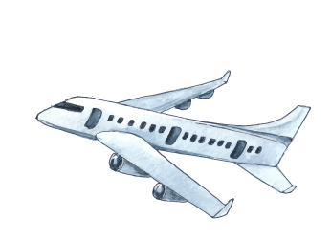




Pathfinder: Your Ultimate Trip Planner
Natalia G., Justin M., Nico R., Gavin R.
Our best trip!

Slide 2

Table of Contents
Our Initial Idea
Research
Development Process
Prototype
Demo
Next Steps
Notes:
NATALIA

Slide 3
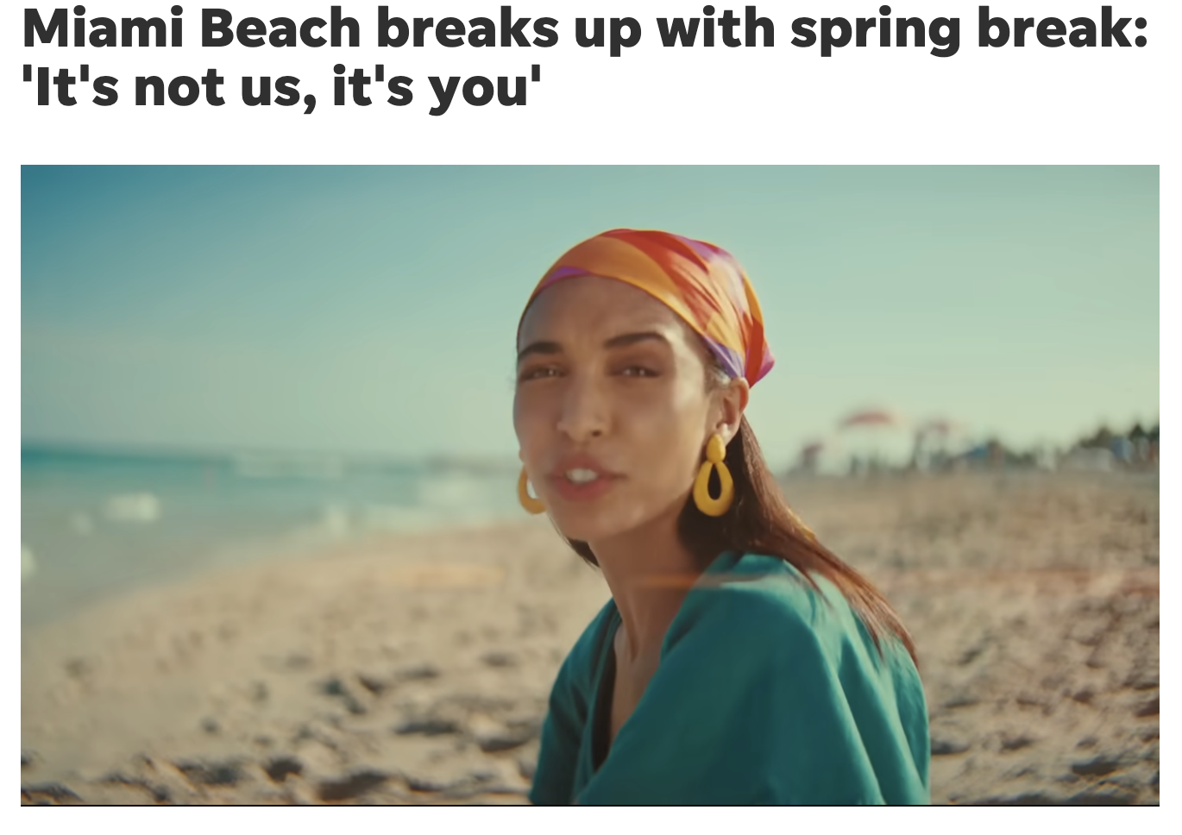

01
Initial Idea
In 2024, Miami Spring Break Ban
Ban included restricted beach access, curfews, higher prices
As a result, enjoying spring break has become increasingly difficult for college students
Want to find locations given user inputted parameters
Notes:
NATALIA
Explain what your initial idea was and why you chose it

Slide 4
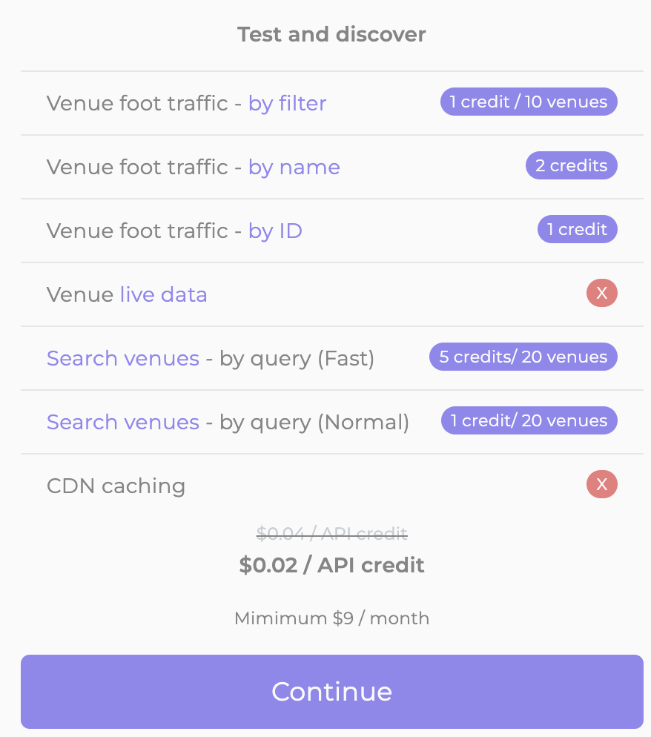
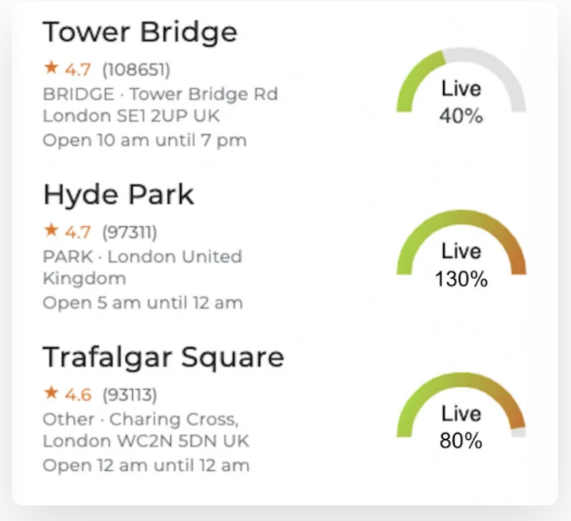

02
Research
Amadeus API (left)
Drawback: the price.
Previous APIs:
Amadeus (flight, hotel, and destination information APIs)
BestTime (foot traffic, general busyness, and rating of attractions)
BestTime API (right)
Showing crowd levels in London are
Notes:
GAVIN
Summarize the research you did for this project – what did you learn from users
and from your own research? How did it shape your prototype?

Slide 5

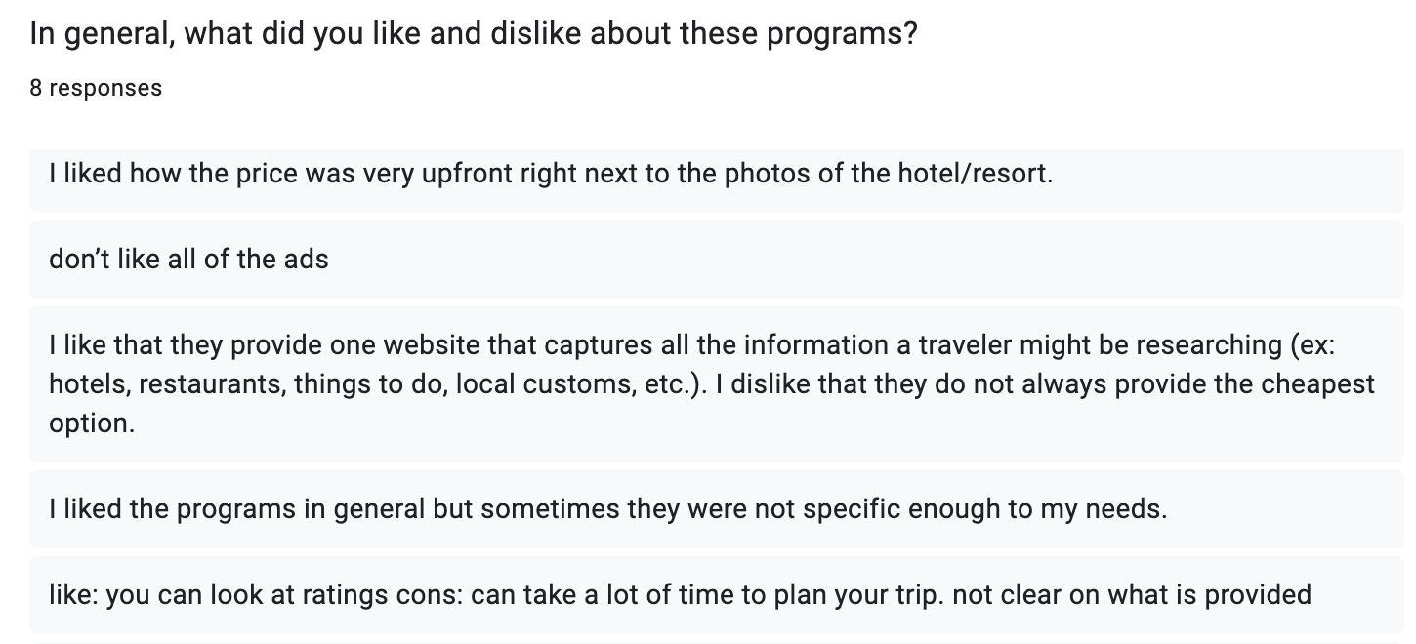

02
Research (cont.)
User responses:
Notes:
GAVIN
Summarize the research you did for this project – what did you learn from users
and from your own research? How did it shape your prototype?

Slide 6
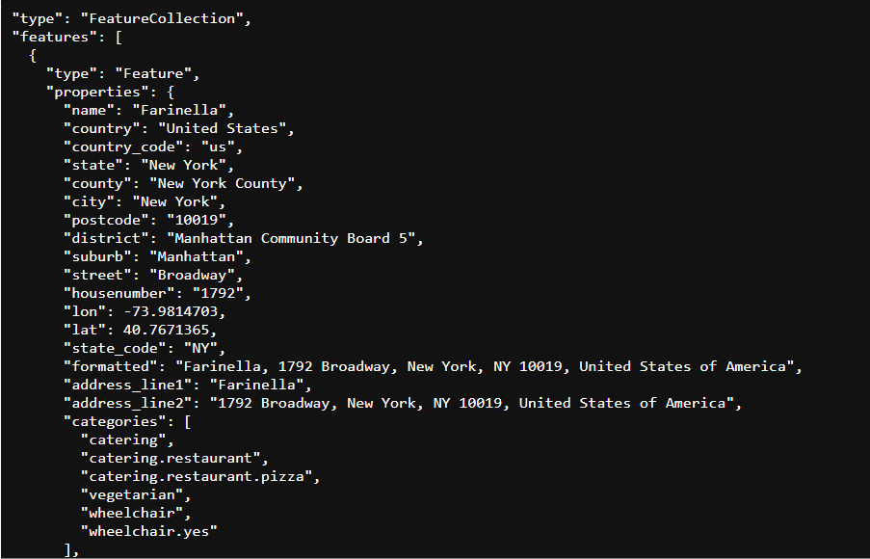
03
Development Process
The development process was simple:
Backend code happened to be reusable without us realizing
The FaceBook lab helped us out a lot
.pack() and .grid() were confusing at first
API calls were readable
Notes:
NICO
Describe how the development process went. How did you work through your
debugging? What other obstacles, or happy accidents, did you stumble upon?

Slide 7
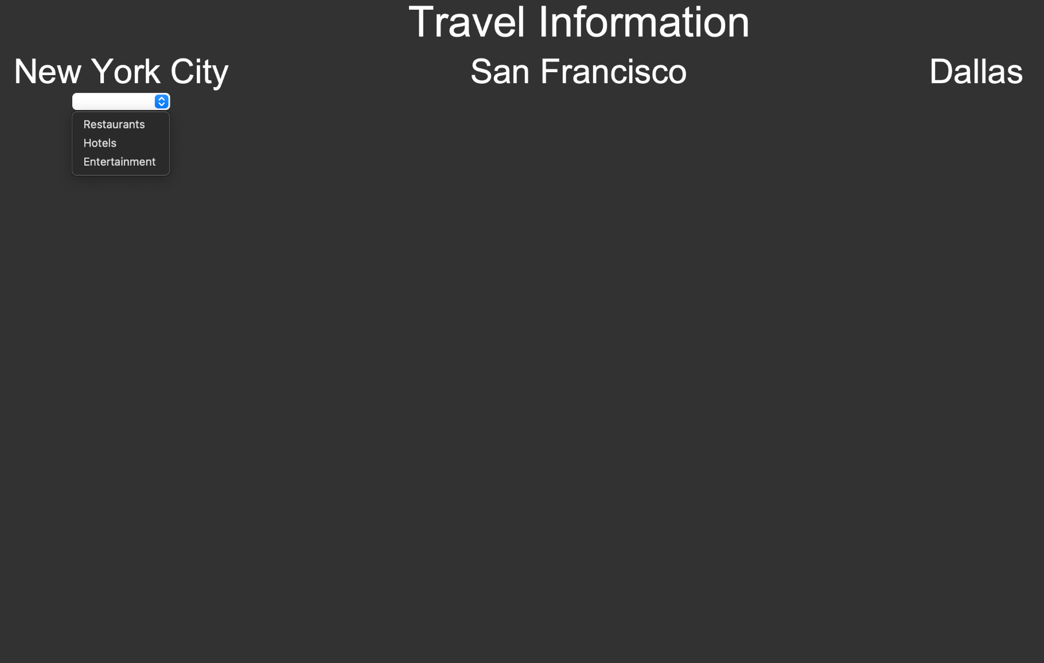
04
Prototype Testing
We got a better idea of how we want to format the info on the page
It was only after prototype testing that we realized that the restaurant call was generalizable to the other fields
Notes:
JUSTIN
Explain what you learned from the full prototype testing. How did your project change between then and now?

Slide 8
05
Live Demo

Slide 9
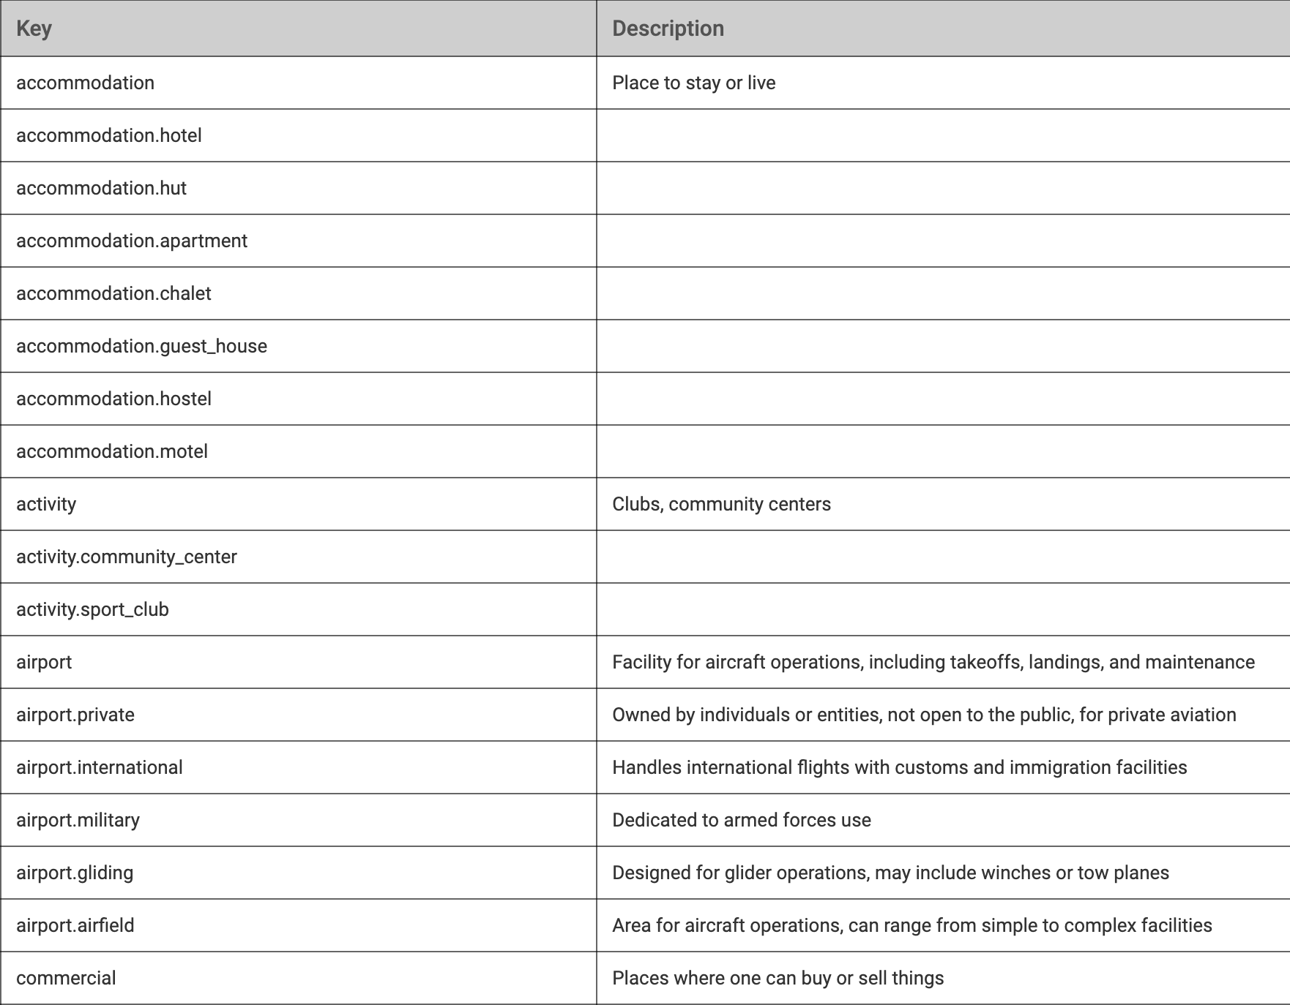
06
Next Steps
This semester
Make it more aesthetically pleasing (padding, colors, fonts)
Think of users confusion/error
With more time
Try categories other than food, entertainment, and lodging
Expand our list of cities
Notes:
ALL
Briefly discuss what your next steps are from now until the end of the semester.
How will you continue to build on the program? What could you do with it if you
had another full semester to puzzle it out?

Slide 10
Thank you!
We look forward to your feedback :)

